Slide 1
CSE 385
M. Stahr
Database Systems
Week 1

Slide 2
Introduction to the course
Professor Stahr
Office: Benton 15
Syllabus
What are we going to cover this semester?

Slide 3
What are we going to cover this semester?
How we work with data storage
Database Systems using mainly Microsoft SQL Server
Building SQL Server tables, views, stored procedures, UDTypes, functions, etc. using scripts
The basics of dB security
We will cover Microsoft C# as a front end to our database
We will use C# to build web services that interface with a SQL Server dB
We will cover consuming our web service using JQuery
Time permitting:
We will learn how to access our database system using Java

Slide 4
What will our tools be this semester:
We will be using Microsoft SQL Server (MSSQL) as our database (dB)
We will be using Microsoft Visual Studio C# to build a gateway to our dB
We will use a modified version of SQL Server Management Studio (SSMS) to work with our database. This version of SSMS is built into Visual Studio and does everything we need it to do but is not as user-friendly as the stand-alone SSMS version.
We will create Web Services in C# that will talk with our dB
We will use jQuery in order to contact our web service
We will use HTML (as well as .aspx) pages to display our data we get back from our web services

Slide 5
Microsoft Products used in this class
Lets get set up with our environment in order to work with our database systems.
Because we are online you should download Visual Studio and install it on your computer. If you have Windows that is a MUCH easier process. If you have a mac this will be more difficult.
Windows: https://visualstudio.microsoft.com/downloads/
Mac: https://adamwilbert.com/blog/2018/3/26/get-started-with-sql-server-on-macos-complete-with-a-native-gui (Links to an external site.)
If you are using a school PC then from the start menu navigate to:
CEC Applications → Programming Languages → Visual Studio → Visual Studio
Note: DO NOT select the Blend version
You do not have to create an account with Microsoft – so, if asked, just skip it.
The left-hand tabs will probably only have “Server Explorer” and “Toolbox” but we will want one more…
Click on “View” from the top menu and select “SQL Server Object Explorer”
Once you’ve got to this point you will have an easy way to create a database and a C# application that could be a website, web service, desktop app, mobile app, etc.

Slide 6
Once you are all set up…
So what is a database? What’s it used for? Have you ever used one?
One advantage you all have learning database systems is that you’ve taken 271 – OOP (Object Oriented Programming) because building and working with a database is closely related to OOP.
A dB is used to store and retrieve data…
A typical dB stores information about a single topic (e.g., Sales)
This information is broken down by related entities called tables that usually relate to a real-world object (e.g., Car.java)
A table is constructed from columns and rows (like a spreadsheet)
Each column in a table is used to store an attribute (property) of the entity (e.g. make, model, year, ownerName)
Each row of a table is used to store an instance of the entity.

Slide 7
Basic dB form
An example of a simple OOP setup and structure of a basic database
Employee
tblEmployee
EmployeeTracker
EmployeeTrackerDb
tblMachine
Machine
Product
tblProduct
Project
Database
Classes
Tables

Slide 8
Database Options
There are many different types of database out there on the market. Here is a list of a few of the best dB Software Systems*:
(RDBMS: Relational Database Management System)
Oracle RDBMS (“…designed for grid computing, is the best RDBMS…”)
IBM DB2 (“While DB2 is not likely to over perform Oracle in market share, it is definitely secured in the second position”)
Microsoft SQL Server (“…Microsoft has made strategic investments to push its SQLServer to the frontline to compete with Oracle and DB2 head-to-head.”)
SAP Sybase ASE (“used to be one of the big 3 database giants (with Oracle and DB2) dominating the database field, but Sybase lost its momentum overtime”)
Teradata (“is the most powerful Very Large Database (VLDB) system”)
ADABAS (“Adabas once was the most powerful mainframe database”)
MySQL (Becoming one of the most popular dB systems on the market for web based systems. Now owned by Oracle)
FileMaker
Microsoft Access
Informix
*http://www.itcareersuccess.com/tech/database.htm

Slide 9
Structure of a Database
Tables – stores data
Views – consolidates / filters data from multiple sources in the dB
Stored Procedures – scripts / queries
Functions – built in and user defined dB methods
Data types – built in and user defined dB types

Slide 10
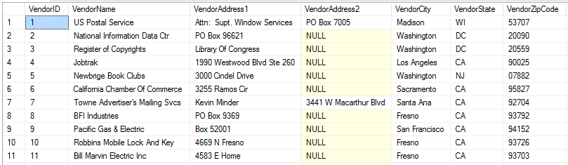
Database Tables
Tables are used to store data in a database through a grid system of columns and rows
Think of a table as a class (e.g., Car, Employee, Vendor, etc)
Made up of columns (think of these as class properties) and rows (think of these as instances of a class: e.g., Vendor v1 = new Vendor(); v1.VendorID = 1;)
If properly constructed – tables are used to store data about a single entity without repeating entry data.
Each row will have one or more columns that uniquely identify that row – the KEY field(s)

Slide 11
Creating a table
Creating a table is quite simple through the GUI interface and not much different when created by a script. Lets create a Friend table using a script. Note that our book does not use a prefix to dB objects and uses plural names rather than singular as table names. This can be argued either way but it really comes down to convention and it’s more important to being consistent than not.
For our course will use the following prefixes to our dB objects (tbl, vw, sp, fn, udt)
CREATE TABLE tblFriends (
friendId INT NOT NULL IDENTITY PRIMARY KEY,
firstName VARCHAR(20) NOT NULL,
lastName VARCHAR(20) NOT NULL,
age INT NOT NULL DEFAULT 0,
phoneNumber VARCHAR(20) NOT NULL DEFAULT ''
);
FriendID – A unique identifier for a single row (the KEY field). Every table should have a way to uniquely identify a row.

Slide 12
This is a bunch of CRUD!
CRUD is a term we use to describe the interaction we have with a dB.
C – Create (adding records)*
R – Read (querying the database to retrieve records)*
U – Update (updating current values in the dB)
D – Delete (removing records from the dB)
With these 4 we can manipulate our database in order to build sophisticated systems.
* Are required to be considered a database

Slide 13
Adding rows to a table (Create - Crud)
One way to add rows is simply adding them by hand. This works just fine for small amounts of data
Another way is to run a script that adds rows to your table. Here are 2 examples:
SET IDENTITY_INSERT tblFriend ON
INSERT INTO tblFriend (friendID, firstName, lastName, age, phoneNumber) VALUES (1, 'Tom', 'Ryan', 25, '111-222-3333')
INSERT INTO tblFriend (friendID, firstName, lastName, age, phoneNumber) VALUES (2, 'Sally', 'Right', 23, '222-333-4444')
INSERT INTO tblFriend (friendID, firstName, lastName, age, phoneNumber) VALUES (3, 'Jack', 'Ryan', 24, '333-444-5555')
INSERT INTO tblFriend (friendID, firstName, lastName, age, phoneNumber) VALUES (4, 'Mary', 'Light', 27, '')
SET IDENTITY_INSERT tblFriend OFF
or even better - simply comma separate your data records:
SET IDENTITY_INSERT tblFriend ON
INSERT INTO tblFriend (friendID, firstName, lastName, age, phoneNumber)
VALUES (1, 'Tom', 'Ryan', 25, '111-222-3333'),
(2, 'Sally', 'Right', 23, '222-333-4444'),
(3, 'Jack', 'Ryan', 24, '333-444-5555'),
(4, 'Mary', 'Light', 27, '')
SET IDENTITY_INSERT tblFriend OFF

Slide 14
Setting your own value for the primary field
A table with a primary key field set to IDENTITY will auto generate the primary key value each time you add a row; however, if you want to insert your own unique primary key you must first tell SQL that you want to insert your own identity value. We do this by using the form:
SET IDENTITY_INSERT [table] ON
When you are done inserting the record(s) you must remember to turn off the manual identity by:
SET IDENTITY_INSERT [table] OFF

Slide 15
Adding rows to a table (Create - Crud)
So what if we want to generate a lot of test data? What is the best way to import a mass amount of data from a file – how would you solve this?
By using a Bulk Insert
There are a number of websites that will generate test data for you but the best one I’ve found is: https://www.mockaroo.com/ (Intro to mockaroo.com)
Bulk Insert Example:
BULK INSERT [table]
FROM '[filePath/filename]'
WITH (
FIRSTROW = [first row data starts on. This is 1 based],
ROWTERMINATOR = 'indicate the line delimiter (ex: \n)',
FIELDTERMINATOR = 'indicate the field delimiter (ex: \t)',
KEEPIDENTITY
)
FIRSTROW = What line the data starts on in the file. This is 1 based
ROWTERMINATOR = What character represents the end of the line character
FIELDTERMINATOR = The character that is used to separate fields in a line
KEEPIDENTITY = Used when file contains an ID field that needs to be imported

Slide 16
Bulk Insert Example (Create - Crud)
Right-click on your database and select “New Query”
Type the following into the query window and run
CREATE TABLE tblCars (
Id INT NOT NULL IDENTITY (1, 1) PRIMARY KEY,
vin VARCHAR(17) NOT NULL,
make VARCHAR(30) NOT NULL,
model VARCHAR(30) NOT NULL,
year INT NOT NULL,
);
Download the file: CarData.txt from Canvas. Found in Files/Handouts folder and save it to your c:\temp folder
Delete the CREATE TABLE code in your query window then type and run the following:
BULK INSERT tblCars
FROM 'c:\temp\CarData.txt'
WITH (
FIRSTROW = 2,
ROWTERMINATOR = '\n',
FIELDTERMINATOR = '\t',
KEEPIDENTITY
);

Slide 17
Retrieving data from a dB (Read - cRud)
Retrieving data from a dB is a very important aspect when working with systems
We will learn layers and layers of ways to read data from a database but here is a simple example
SELECT * FROM tblCars WHERE make = 'Honda';

Slide 18
Updating records in a dB (Update - crUd)
Although updating records isn’t required it is often used when one works with a dB
Here is a simple example of an update to a table alone with a select (Read)
UPDATE tblCars SET make = 'HONDA' WHERE make = 'Honda';
SELECT * FROM tblCars WHERE make = 'Honda';

Slide 19
Deleting rows to a dB (Delete - cruD)
There are two basic ways to remove all data from a table:
DELETE FROM tableName
TRUNCATE TABLE
Advantage / disadvantages
Some examples:
DELETE FROM tblCars WHERE make = 'Honda';
SELECT * FROM tblCars WHERE make = 'Honda';
TRUNCATE TABLE tblCars;
SELECT * FROM tblCars;

Slide 20
Running a database script file
Download the create_ap.sql script file from Canvas. This are located in the Database Scripts folder under Files.
In Visual Studio, click the Open File icon on the top menu
Select the script file (create_ap.sql)
Click the small green run arrow in the create_ap.sql tab and run it.
When asked to select a server expand Local and pick the MSSQLLocalDB and click Connect
Right click onto the Database folder and select Refresh to see that your databases imported

Slide 21
Looking at data
We will take some time to look at the tables in the database and see how things are related.

Slide 22
Designing a dB
During the semester we will be working a lot with pre-created dBs; however, it is very important that you learn how to create a dB yourself. Not only that, you need to have the skills to create a dB from an idea…
Lets take the following system and build a database:
Create a system to be used by a university. The system needs to account for teachers, students, courses
tblTeachers | tblStudents | tblCourses | tblTeacherCourses | tblStudentCourses
teacherId | studentId | courseId | teacherId | studentId
teacherName | studentName | courseName | courseId | courseId
 |  | courseCredits |  | studentGrade

Slide 23
UniversityDB
tblTeachers
tblCourses
tblStudents
tblTeacherCourses
tblStudentCourses

Slide 24
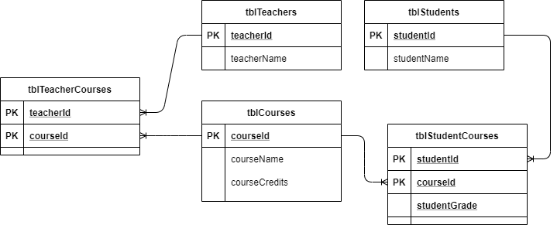
UniversityDB

